Slide 1
Black-PC
Differentiate insider attacks from credential abuse

Slide 2
High security boot process
Multiple isolated workspaces: Internet vs Intranet
Convenient & safe content consumption
Tampered proof hardware monitoring
Notes:
Users does not need to deal with multiple machines, one for Internet one for Intranet. For laptop form-factor, mobile executives can use the Internet with ease knowing all threats are contained within the Internet VM. All confidential work contents are safely kept in the Intranet VM. This deck focuses more on the hardware monitoring, especially for the purpose of differentiating Insider from externally controlled threats.

Slide 3
Internet VM
Makes conventional trojans/malware irrelevant
Revert to clean state with a reboot
Gets URL links safely from Intranet VM
Secured hypervisor, virtual-BIOS & hardware security provides isolation
Intranet VM
Gets screen-shot & text buffers safely from Internet VM
Tamper proof hardware monitoring of Insider Threats
Notes:
Unlikely commercial type-2 hypervisor which are complex & can be exploited to escaped so as to access the host system. Our Black-PC uses multiple approach to ensure the 2 zones are safely isolated, only allow limited data flow between VMs.

Slide 4
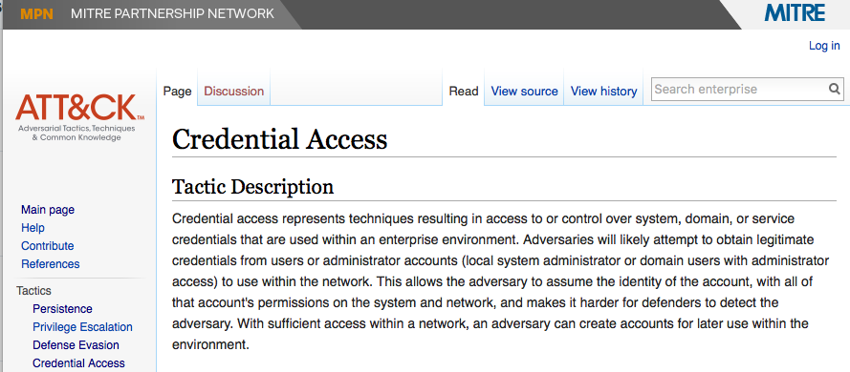


To answer if it is Insider Threat, we need to be sure that the credentials were not abuse by external actors…
Notes:
https://attack.mitre.org

Slide 5
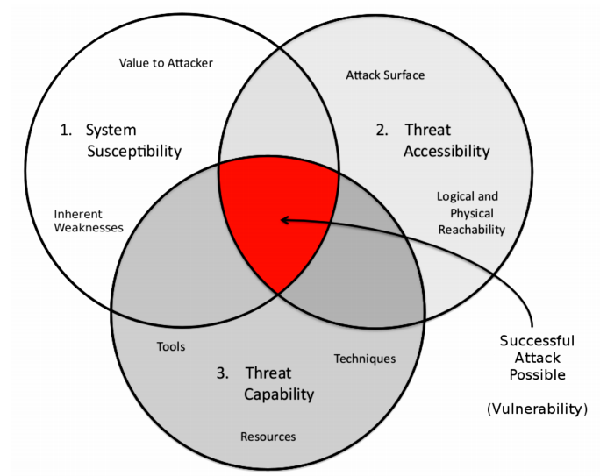
Denies Threat Accessibility
Notes:
No amount of hardening &/or buying security products will address the problem of complex & vulnerable Operating Systems & Applications.
An attack can be denied so long one or more of the requirements are NOT met. Black-PC denies Threat Accessibility by compartmentalisation of vulnerable Operating Systems.

Slide 6
Tamper proof hardware monitoring
Video, USB, Mouse, Keyboard & hardware I/O are recorded & monitored at hardware level
Cannot be tampered by OS-level threats
Does not monitor OS-level anomalies, works together with ETDR &/or UEBA for advance detection of both insider & abuse of credentials
Notes:
If we just want to separate the network from Internet, it can be done easily via Internet kiosks. However, Black-PC does beyond that. Our hardware monitoring is totally invisible to the Operating System, be it Windows or non-windows OSes. It cannot be tampered by Operating System level threats like malware and other forms of sophisticated software techniques.
Given the popularity of Endpoint Threat Detection & Response & User-Entity Behaviour Analytics products. Black-PC will enhance these security investments as tamper-proof instrumentation. It provides the missing hardware level evidence to either prove or disprove the type of attacks, be it insider &/or abuse of credential.

Slide 7
Air-Gap is no silver bullet…
It increases the bar & cost-of-attack
Let’s look at a few advance threat scenarios
Notes:
We can think of BlackPC as a part of an air-gap eco-system, with the intent not just to provide a high assurance computing platform, but to enhance usability at user experience level & ease-of-management for IT operations, rather than dealing with 2 fleets of devices one for Internet & one for Intranet.
Even within the air-gapped internal/intranet zone, We still need to monitor sophisticated Command & Control (C2) that are designed to circumvent air-gaps.
Depending on the environment, it may still be possible to take over an Intranet zone especially the adversary is capable of planting the C2 server within the Intranet zone. Some examples include rogue printers, Email C2 & through USB devices.
In the following slides, we touch on a few advance threat scenarios…

Slide 8

Brutal Kangaroo tool suite
Alleged CIA Air-Gap Hacking Tool
Air-gapped target
Notes:
Both Primary Host and Secondary Target are presumably infected by this supposedly CIA toolkit known as Brutal Kangaroo. By infecting a whitelisted USB drive, the adversary is capable of performing all those steps stated in the illustration. So how does BlackPC deals with this type of C2 approach?

Slide 9
BlackPC vs Brutal Kangaroo
Reduce reliance on USB drives. Together with our secure file transfer product, we achieve seamless & sanitised one-way content ingestion or content transfer between zones (Dropbox like experience)
USB storage encryption to mitigate file tainting or infection
Our hardware event recording together ETDR &/or UEBA speed up identification of threat; we record all USB hardware events & screen captures
Endpoint Threat Detection & Response
User Entity Behavioural Analytics
Notes:
The key problem with whitelist USB storage is that it can be used with questionable assets. The more “advance” USB storage may have multi-factor authentication to mount the storage partition, but after which, any malicious process within the questionable machine can infect the contents within the mounted partition.
We designed our one-way content sanitisation solution to wean off the reliance of USB storage. But even if we have to use USB storage, our Black-PC is capable of encrypting the USB storage with a shared key such that it is only usable within a fleet of Black-PCs/laptops.
*side-note, since there are typically > 2 ports, we may want to consider the capability to allocate 2-plain USB ports for Internet VM and 2-encrypted USB ports for Intranet side for the sake of “interoperability”. Old habits will die hard.

Slide 10
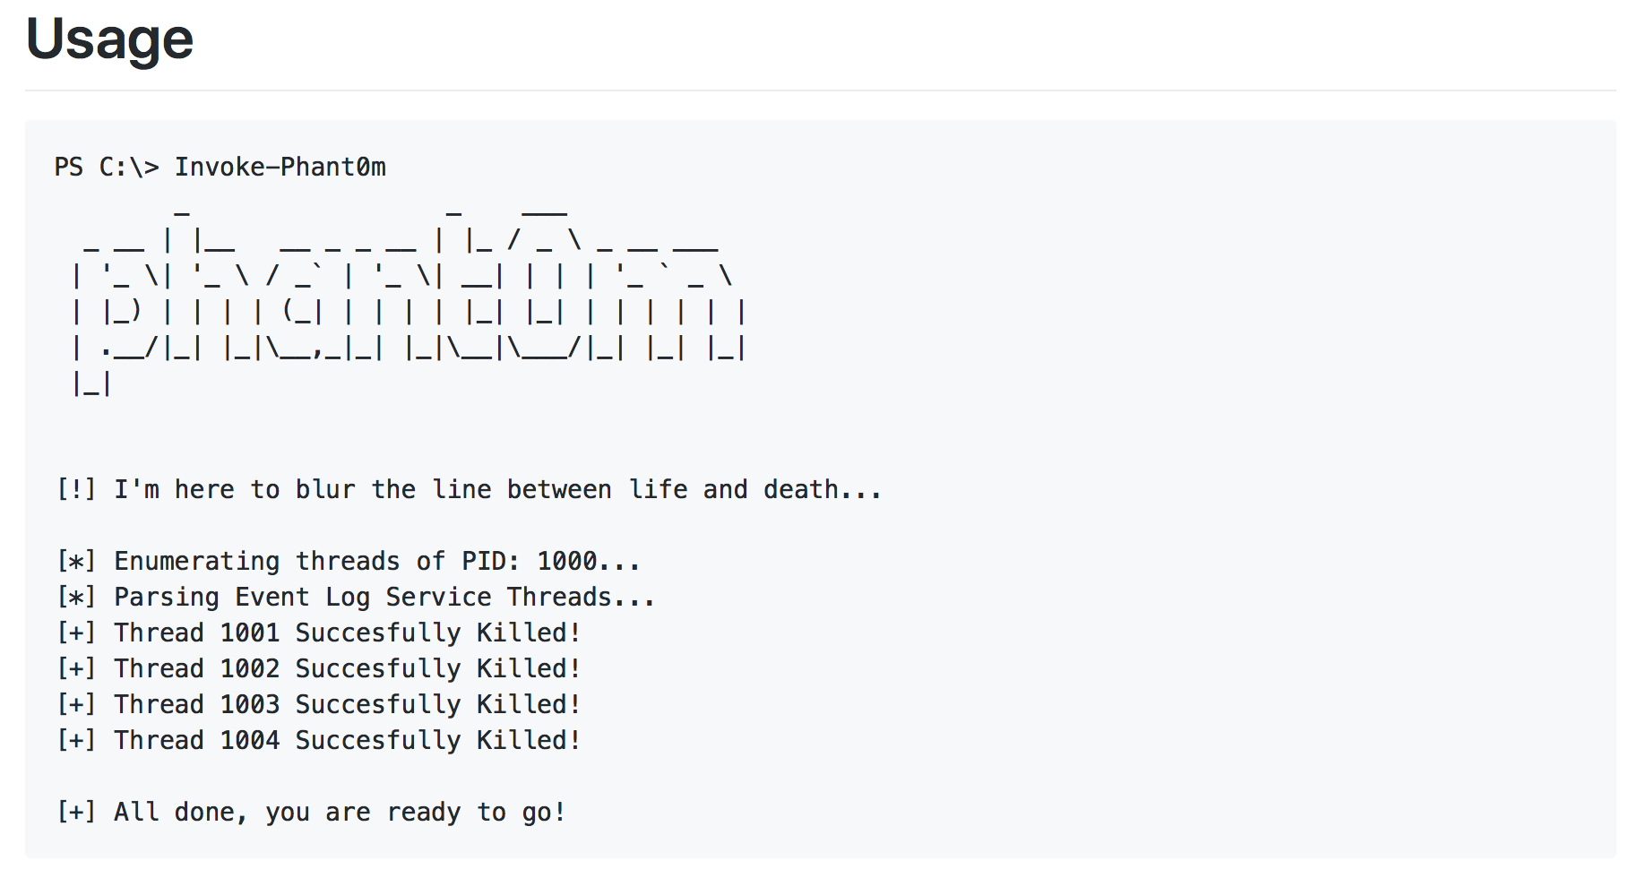
Invoke-Phantom - Event Log Killer
Public tool in Github*
Event Log Service will still look like it is running…
Used after remote attacker gains system privilege
No logging because all threads are killed
*Opensource source code repository
Notes:
Most of these advance actors tend to be fully automated & autonomous, much like a virus with advance call-back capabilities. Instead of disarming endpoint protection, some may opt to disable logging so that its actions go undetected without triggering any attention by security monitoring operations.
https://github.com/hlldz/Invoke-Phant0m
This is a publicly available tool to disable Windows Event Logging without stopping the service. This tool instead kills the working threads of the Windows service to silence logging.

Slide 11
BlackPC vs Invoke-Phantom
BlackPC records hardware activities like Video, Keyboard & Mouse, I/O-bus & so on…
SIEM/Analytics alerts the inconsistency of hardware activities but OS logging silence
We then inspect users’ activities prior to event. If found to be benign, then it should be a background backdoor process* that disarmed logging
This capability is useful to detect technical insider eg. Snowden^ Problem (NSA contractor-sysadmin)
* Analyst can simultaneously check for host logs prior to the silence to hunt for Indicators of Compromise
^ Such users have the rights to execute system privilege commands
Notes:
Windows or any other OS tend to emit event logs periodically even when in idle state. As such, a simple SIEM rule can check for existing hardware activities but total silence of OS logging as anomaly. This is useful to detect active tampering of OS logging facilities.

Slide 12
Concrete Evidence
not circumstantial evidence that can be fabricated &/or erased by advance threat actors

Slide 13
So far, the scenarios are related to disambiguating credential abuse
How about Insider Scenarios?

Slide 14
Using unnamed accounts or someone else’s account
Notes:
Despite all the audits we can have, there are still instances where unnamed shared account are abused. Another account related abuse is the use of someone else’s account.

Slide 15
Smile… Login…
Active attempt to block web-cam before login is certainly suspicious
Work together with authentication solutions to snap user’s face during login phase
Perform active facial-userid matching
Addresses loop-hole of unnamed account or misusing other accounts
Notes:
Recall the Black-PC has full control over the hardware buses. Black-PC along with a web-cam together with a suitable facial recognition solution can solve this. The solution can work capture both successful and failed attempts. Together with advance analytics, the integrated solution can flag spoofing attempts, example the use of 2D image for facial recognition.

Slide 16
Collaboration Areas

Slide 17
INTERNET Zone
INTRANET Zone
File sanitisation
DECEPTION Zone (honeynet)
Notes:
Deception is becoming more mainstream. New start-ups solve much of the complexity of setting up honey-nets and so on. Black-PC can fit well with these products since it naturally separate into at least 2 networks; Internet vs Intranet.
When we configure the Internet VM to have limited use-cases like surfing with browser & reading external docs. Our Black-PC Internet zone together with Deception products gives us early warning & threat intelligence in terms of the gaining insights to adversaries’ Tactics, Techniques & Procedures.

Slide 18
Other Security Products
Endpoint Threat Detection Response
User Entity Behavioural Analytics
Biometrics & Behavioural Authentications
Privilege User Management & Monitoring
Isolation Platform with anti-email-phishing controls eg. Menlo Security
Notes:
First two products still depend on traditional logging methods which can be circumvented (as shown earlier with Invoke-Phantom tool). With a Black-PC fleet, we are sure that there is anomaly when there are users’ hardware activities but SIEM/SOC is not receiving log data from machine.
Our high assurance hardware activities signals can be inputs to Behavioural-based authentication methods or sometimes also known as Continuous Authentication. We also can naturally complement existing PUMM products like CyberArk, Xceedium and so on.
Lastly, we can pair together with IP such as Menlo Security for added security since Black-PC don’t deal with phishing.

Slide 19
Q & As

Slide 20
Why not buy 2 separate fleets?
More IT & security monitoring cost-effort.
If Internet zone fleet has relaxed configuration/flexibility, what’s stopping users from creating & leaking sensitive contents? As if securing intranet is not enough…
Incur more USB storage sticks (see allegedly CIA Cruel Kangaroo toolkit). Whitelisted drive plugs into Internet station then to Intranet machine, just like the flow diagram earlier.
It may look cheap on the surface, but there are hidden costs & management issues to deal with
Notes:
One fleet of devices for Internet, the other for Intranet. We may argue that the first point is also applicable to Black-PC but our VMs have roll-back capability, particular useful for remediation at Internet zone.

Slide 21
Why not just surf the internet within a VM?
VirtualBox, VMware & the likes are type-2 hypervisors. Type-2 hypervisors are being well-studied for vulnerabilities.
Host OS tend to have direct Internet access, so if malware gets in via non-browser means (MiTM deliver, USB…), remote-control/take-over can still happen.
No data flow control to mitigate Insider threats/abuse-cases.
Notes:
https://www.cvedetails.com/vulnerability-list/vendor_id-93/product_id-20406/Oracle-Vm-Virtualbox.html
https://www.cvedetails.com/vulnerability-list/vendor_id-252/product_id-6561/Vmware-Player.html

Slide 22
Why not “Isolation Platforms”?
Once Host OS direct Internet access (eg. laptop that needs hotel wifi), so if malware gets in via non-browser means (eg. MiTM delivery, USB…), remote control/take-over can still happen.
Once malware gets in, it is trivial to add an proxy bypass setting to defeat such controls for more “relaxed” environment. Put it another way, more complex configuration & maintenance to truly harden the endpoints.
That being said, Isolation Platforms like Menlo-Security have good anti-email-phishing controls.

